Slide 1

Customer Shopping Behavior Analysis
Analyzing 3,900 customer transactions to uncover insights into spending patterns, customer segments, and product preferences that drive strategic business decisions.

Slide 2
Dataset Overview
3,900
18
37
Total Purchases
Data Points
Missing Values
Transactions analyzed across all categories
Features covering demographics and behavior
Only in Review Rating column
Customer Demographics
Shopping Behavior
Age, Gender, Location
Purchase patterns and frequency
Subscription Status
Discount usage and ratings

Slide 3

Data Preparation in Python
01
Data Loading & Exploration
Imported dataset using pandas, examined structure with df.info() and summary statistics
02
Missing Data Handling
Imputed Review Rating nulls using median rating per product category
03
Feature Engineering
Created age_group and purchase_frequency_days columns for deeper analysis
04
Database Integration
Connected to PostgreSQL and loaded cleaned data for SQL analysis

Slide 4
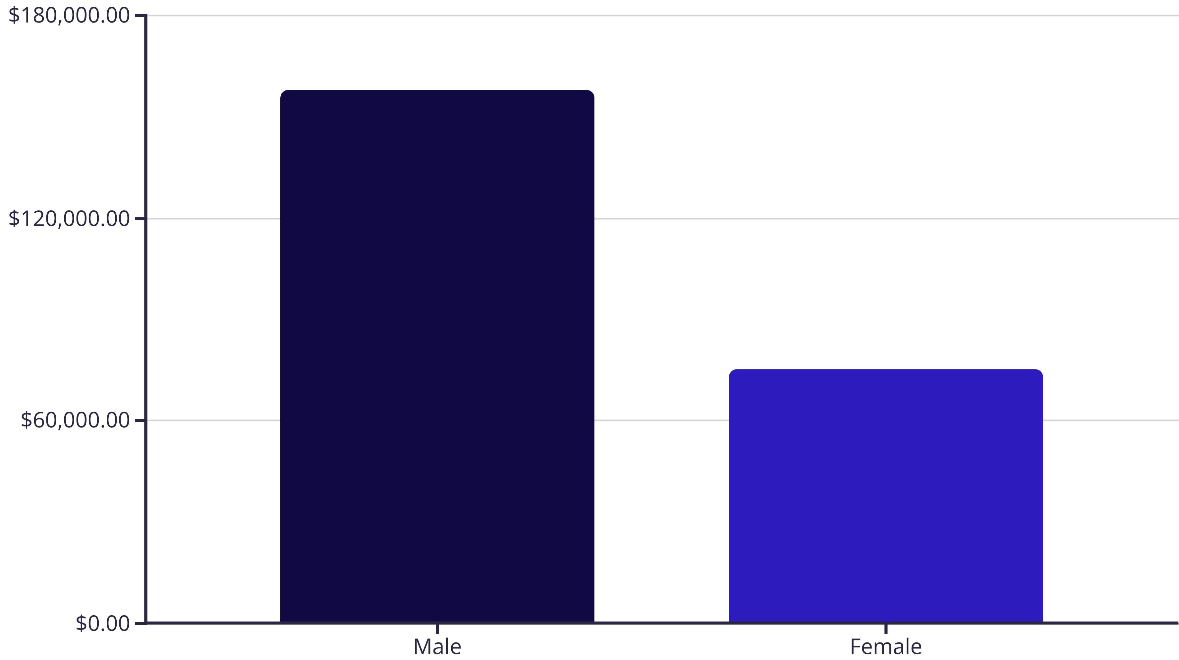
Revenue Analysis by Gender
Male customers generated $157,890 in revenue compared to $75,191 from female customers, representing a significant difference in purchasing power and volume across gender segments.

Slide 5

Top-Rated Products
Gloves
Sandals
Boots
3.86 average rating
3.84 average rating
3.82 average rating
Hat
Skirt
3.80 average rating
3.78 average rating
These five products consistently received the highest customer satisfaction ratings, making them ideal candidates for featured promotions and marketing campaigns.

Slide 6



Customer Segmentation
New
1
0 purchases
Returning
2
424 customers (1-5 purchases)
Loyal
3
3,476 customers (>5 purchases)
The vast majority of customers fall into the Loyal segment, demonstrating strong retention and repeat purchase behavior that drives sustainable revenue growth.

Slide 7
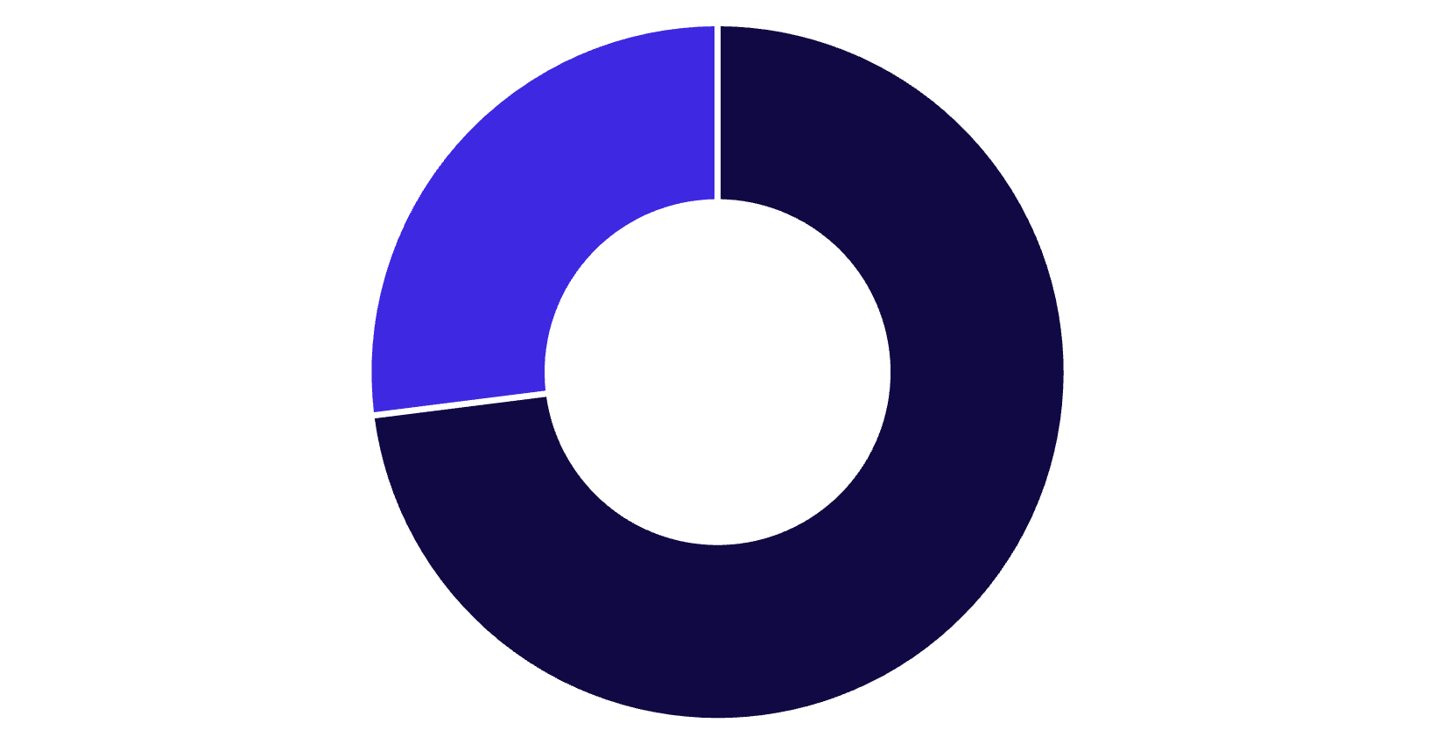
Subscription & Revenue Insights
Subscription Status
Key Findings
Non-subscribers generate $170,436 vs. $62,645 from subscribers, yet average spend is similar ($59.87 vs. $59.49).
Repeat buyers (>5 purchases) show 28% subscription rate (958 of 3,476), indicating opportunity for conversion.
Non-Subscribers
Subscribers

Slide 8
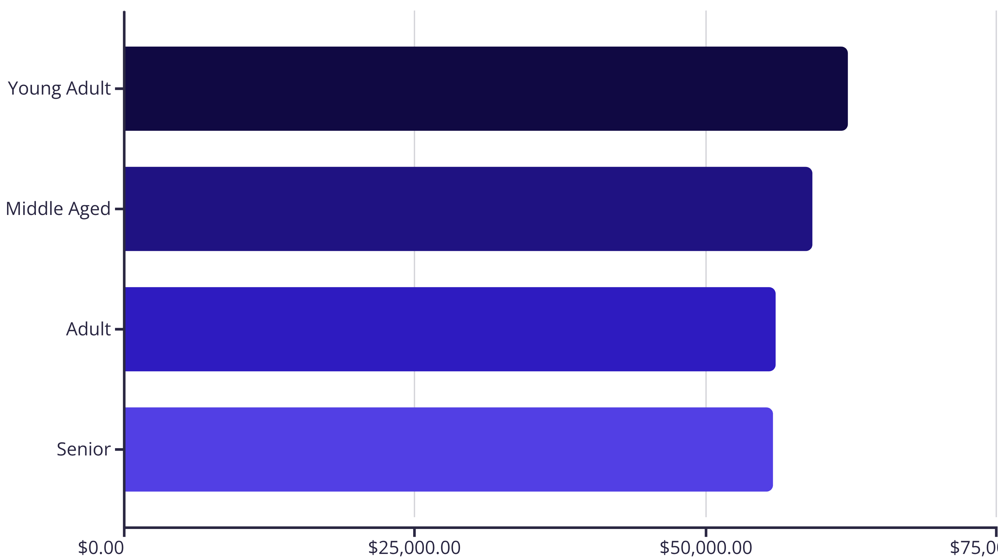
Revenue by Age Group
Young Adults lead revenue generation at $62,143, followed closely by Middle Aged customers. Revenue distribution is relatively balanced across age groups, suggesting broad market appeal.

Slide 9
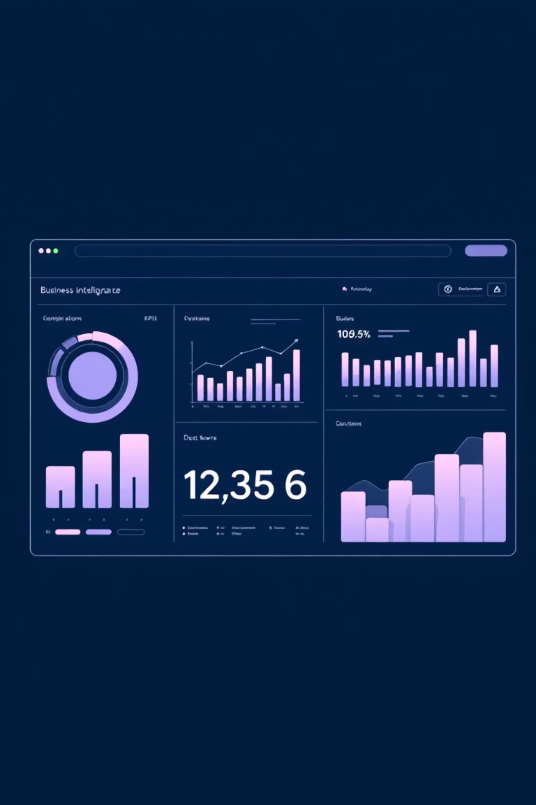
Power BI Dashboard Highlights
Customer Metrics
Subscription Split
3.9K customers tracked with $59.76 average purchase and 3.75 average rating
27% subscribers vs. 73% non-subscribers across customer base
Category Performance
Clothing leads in both revenue and sales volume across all categories
Interactive dashboard enables real-time filtering by subscription status, gender, category, and shipping type for dynamic business insights.

Slide 10
Strategic Recommendations
Boost Subscriptions
Loyalty Programs
Optimize Discounts
Promote exclusive benefits to convert the 73% non-subscriber base
Reward repeat buyers to expand the 3,476-customer Loyal segment
Balance promotional sales with margin control for profitability
Product Positioning
Targeted Marketing
Feature top-rated items like Gloves and Sandals in campaigns
Focus on Young Adults and express-shipping users for maximum ROI

